Slide 1
Staying alert
Revelation 3:1-6
To the angel of the church in Sardis write: “These are the words of him who holds the seven spirits of God and the seven stars. I know your deeds; you have a reputation of being alive, but you are dead. Wake up! Strengthen what remains and is about to die, for I have found your deeds unfinished in the sight of my God.

Slide 2
Staying alert
Revelation 3:1-6
Remember, therefore, what you have received and heard; hold it fast, and repent. But if you do not wake up, I will come like a thief, and you will not know at what time I will come to you. Yet you have a few people in Sardis who have not soiled their clothes. They will walk with me, dressed in white, for they are worthy.

Slide 3
Staying alert
Revelation 3:1-6
The one who is victorious will, like them, be dressed in white. I will never blot out the name of that person from the book of life, but will acknowledge that name before my Father and his angels. Whoever has ears, let them hear what the Spirit says to the churches.”

Slide 4
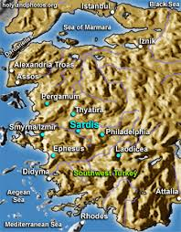
Staying alert
Revelation 3:1-6
Sardis

Slide 5
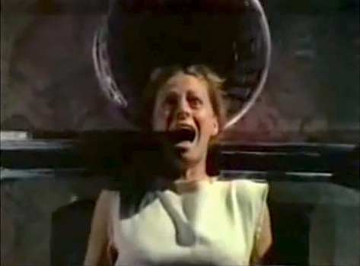
Staying alert
Revelation 3:1-6
Sardis

Slide 6
Staying alert
Revelation 3:1-6

Slide 7
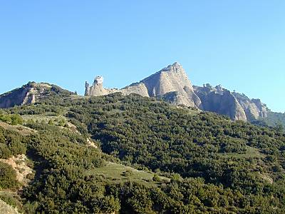
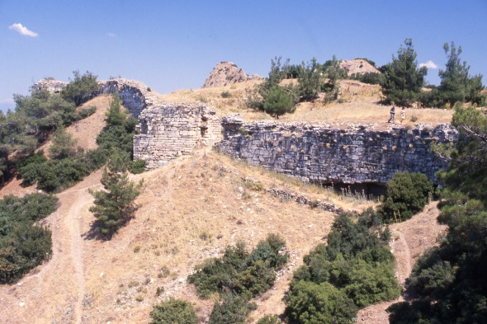
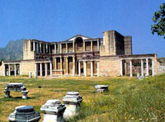
Staying alert
Revelation 3:1-6
Sardis – the context

Slide 8
Staying alert
Revelation 3:1-6
The description of the one who speaks 3:1
These are the words of him who holds the seven spirits of God and the seven stars.

Slide 9
Staying alert
Revelation 3:1-6
The description of the one who speaks 3:1
These are the words of him who holds the seven spirits of God and the seven stars.
Grace and peace to you from he who is, and who was, and who is to come, and from the seven spirits [the sevenfold Spirit] (1:4)

Slide 10
Staying alert
Revelation 3:1-6
The description of the one who speaks 3:1
These are the words of him who holds the seven spirits of God and the seven stars.
These are the words of him who holds the seven stars in his right had and walks among the seven golden lampstands (2:1)

Slide 11
Staying alert
Revelation 3:1-6
The description of the one who speaks 3:1
These are the words of him who holds the seven spirits of God and the seven stars.

Slide 12
Staying alert
Revelation 3:1-6
The description of the one who speaks 3:1
The prophetic message – “I know…”
“I know your deeds; you have a reputation for being alive, but you are dead.”

Slide 13
Staying alert
Revelation 3:1-6
The description of the one who speaks 3:1
The prophetic message – “I know…”
The exhortation - “Wake up”!

Slide 14
Staying alert
Revelation 3:1-6
The description of the one who speaks 3:1
The prophetic message – “I know…”
The exhortation - “Wake up”!
“Strengthen what remains…”

Slide 15
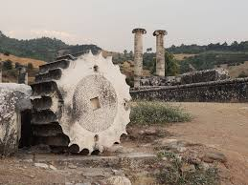
Staying alert
Revelation 3:1-6
The description of the one who speaks 3:1
The prophetic message – “I know…”
The exhortation - “Wake up”!
“Strengthen what remains…”
“I have not found your deeds complete…”

Slide 16
Staying alert
Revelation 3:1-6
The description of the one who speaks 3:1
The prophetic message – “I know…”
The exhortation - “Wake up”!
“Strengthen what remains…”
“I have not found your deeds complete…”
“Remember”!

Slide 17
Staying alert
Revelation 3:1-6
The description of the one who speaks 3:1
The prophetic message – “I know…”
The exhortation
The warning
“But if you do not wake up, I will come like a thief, and you will not know at what time I will come to you.”

Slide 18
Staying alert
Revelation 3:1-6
The description of the one who speaks 3:1
The prophetic message – “I know…”
The exhortation
The warning – impending judgment

Slide 19
Staying alert
Revelation 3:1-6
The description of the one who speaks 3:1
The prophetic message – “I know…”
The exhortation
The warning – impending judgment
The promise
“Yet you have a few people in Sardis who have not soiled their clothes. They will walk with me, dressed in white, for they are worthy. The one who is victorious will, like them, be dressed in white. I will never blot out the name of that person from the book of life, but will acknowledge that name before my Father and his angels.”

Slide 20
Staying alert
Revelation 3:1-6
The description of the one who speaks 3:1
The prophetic message – “I know…”
The exhortation
The warning – impending judgment
The promise
Yet you have a few people in Sardis who have not soiled their clothes. They will walk with me, dressed in white, for they are worthy. The one who is victorious will, like them, be dressed in white. I will never blot out the name of that person from the book of life, but will acknowledge that name before my Father and his angels.

Slide 21
Staying alert
Revelation 3:1-6
The description of the one who speaks 3:1
The prophetic message – “I know…”
The exhortation
The warning – impending judgment
The promise
. I will never blot out the name of that person from the book of life…
No suggestion of losing salvation !! – (See local customs)

Slide 22
Staying alert
Revelation 3:1-6
The description of the one who speaks 3:1
The prophetic message – “I know…”
The exhortation
The warning – impending judgment
The promise
Yet you have a few people in Sardis who have not soiled their clothes. They will walk with me, dressed in white, for they are worthy. The one who is victorious will, like them, be dressed in white. I will never blot out the name of that person from the book of life, but will acknowledge that name before my Father and his angels.
“For I am convinced that neither death nor life, neither angels nor demons, neither the present nor the future, nor any powers, neither height nor depth, nor anything else in all creation, will be able to separate us from the love of God that is in Christ Jesus our Lord.” Romans 8:38-39

Slide 23
Staying alert
Revelation 3:1-6
The description of the one who speaks 3:1
The prophetic message – “I know…”
The exhortation
The warning – impending judgment
The promise
Yet you have a few people in Sardis who have not soiled their clothes. They will walk with me, dressed in white, for they are worthy. The one who is victorious will, like them, be dressed in white. I will never blot out the name of that person from the book of life, but will acknowledge that name before my Father and his angels.

Slide 24
Staying alert
Revelation 3:1-6
The description of the one who speaks 3:1
The prophetic message – “I know…”
The exhortation
The warning – impending judgment
The promise
Yet you have a few people in Sardis who have not soiled their clothes. They will walk with me, dressed in white, for they are worthy. The one who is victorious will, like them, be dressed in white. I will never blot out the name of that person from the book of life, but will acknowledge that name before my Father and his angels.
“Whoever acknowledges me before men, I will also acknowledge him before my Father in heaven.” Matthew 10:32

Slide 25
Staying alert
Revelation 3:1-6
The description of the one who speaks 3:1
The prophetic message – “I know…”
The exhortation
The warning – impending judgment
The promise
General exhortation
“Whoever has ears, let them hear what the Spirit says to the churches.”

Slide 26
Staying alert
Revelation 3:1-6
The description of the one who speaks 3:1
The prophetic message – “I know…”
The exhortation
The warning – impending judgment
The promise
General exhortation
Be vigilant now
“Find rest, O my soul, In God alone; my hope comes from him. He alone is my rock and my salvation…he is my mighty rock, my refuge.” (Psalm 62)

Slide 27
Staying alert
Revelation 3:1-6
The description of the one who speaks 3:1
The prophetic message – “I know…”
The exhortation
The warning – impending judgment
The promise
General exhortation
Be vigilant now
Be vigilant for the future
“Yes, I am coming soon” … “Amen. Come, Lord Jesus” (22:20).

